Slide 1
Analyzing Amazon Sales data

Slide 2
introduction
In today's competitive business landscape, effective sales management is crucial for reducing costs and maximizing profits. As companies strive to enhance distribution strategies and adapt to market demands, understanding sales trends and metrics has become increasingly important.
In this presentation, we will explore a comprehensive sales analysis conducted using an Amazon dataset. Through the ETL (Extract-Transform-Load) process, we will extract relevant data, transform it to derive meaningful insights, and load it for analysis. Our focus will be on identifying sales trends across various dimensions:
Month-wise Analysis: Understanding how sales fluctuate throughout each month.
Year-wise Analysis: Examining yearly sales trends to identify long-term patterns.
Yearly-Month-wise Analysis: Combining year and month data to uncover seasonal effects and other periodic trends.

Slide 3
Extract-transform-load
ETL stands for Extract, Transform, Load, and it is a process used to integrate data from various sources into a central repository, typically a data warehouse or database. Here’s a brief overview of each stage:
Extract: This phase involves retrieving data from different sources, which can include databases, APIs, flat files, or other systems. The goal is to collect raw data that will be processed in the next steps.
Transform: In this stage, the extracted data is cleaned, normalized, and transformed into a format suitable for analysis. This may involve data cleansing (e.g., handling missing values), data enrichment (e.g., adding additional data), and data conversion (e.g., changing data types).
Load: The final step involves loading the transformed data into a target database or data warehouse. This is where the data is made available for reporting, analysis, and business intelligence.

Slide 4
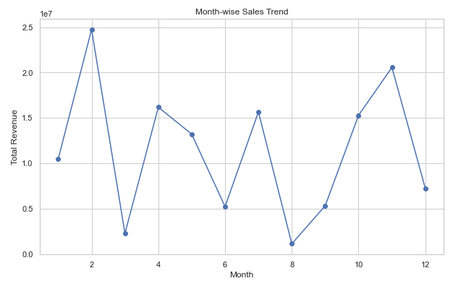
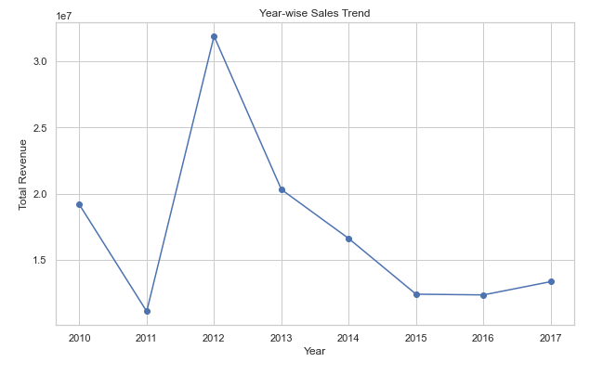
Data visualization

Slide 5
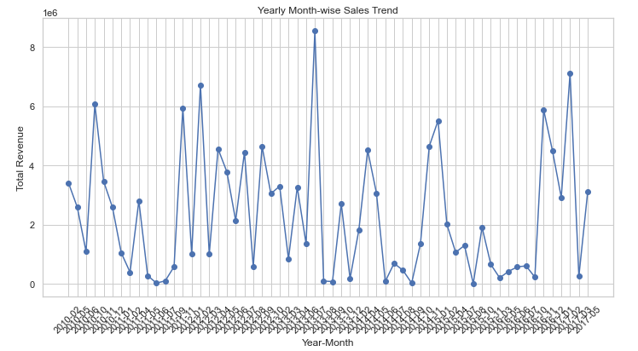
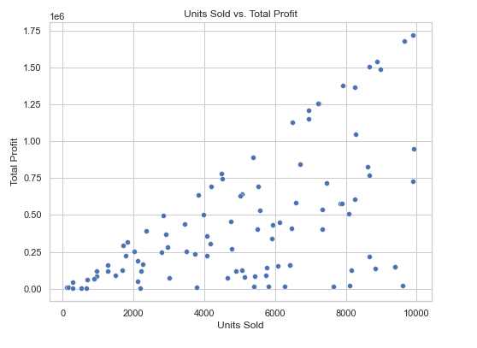
Data visualization

Slide 6
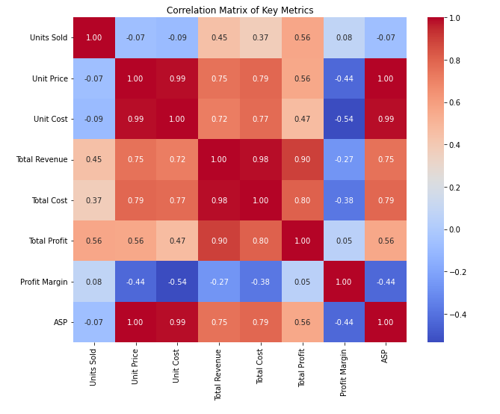
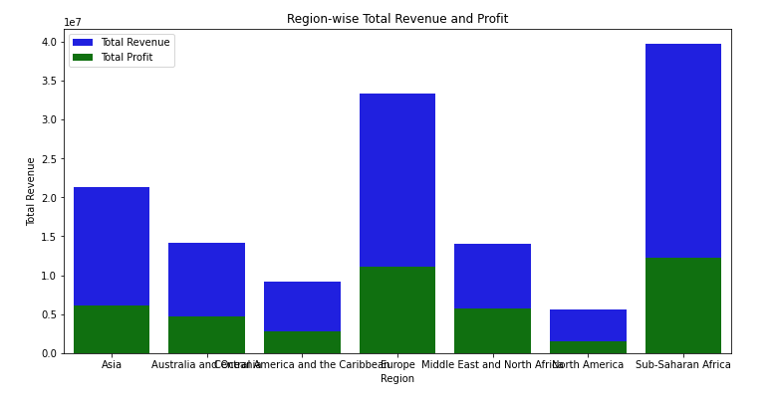
Key metrics and factors

Slide 7
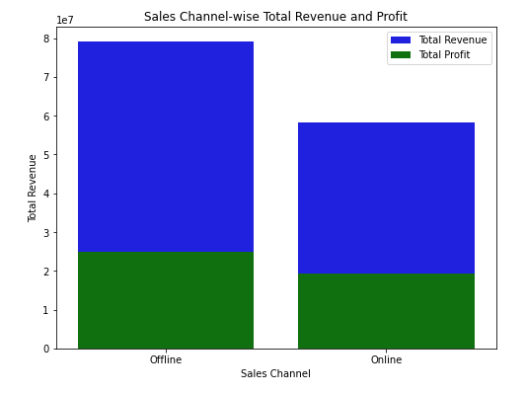
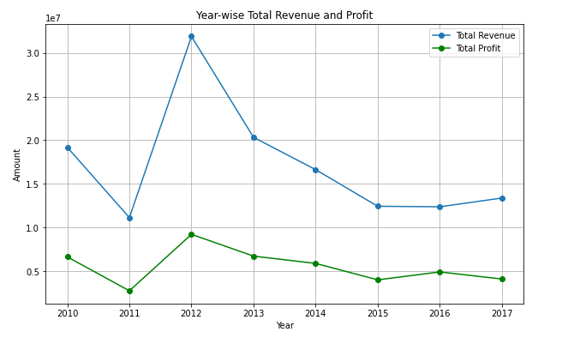
relationships between attributes.

Slide 8
Thank you

